Slide 1


Ministry of Communications and Information Technology
Information Technology Institute
Information Technology Institute
Haitham A. El-Ghareeb, Ph.D.
Associate Professor
Information Systems Department
Faculty of Computers and Information Sciences
Mansoura University
http://www.helghareeb.me
2012

Slide 2
Ministry of Communications and Information Technology
Information Technology Institute
Information Technology Institute
Network Fundamentals
Network Protocols and Devices

Slide 3
Chapter Objectives
Define the meaning of Network Protocol and its benefits
Understand Basics of TCP/IP
Understand Basics of Addressing
Understand Basics of IEEE LAN Standards
Compare between different devices used in networking
Understand differences between Collision Domain and Broadcast Domain
Understand Fragmentation

Slide 4
Network Communication Protocols

Slide 5
The Need for Protocols
Protocols are needed for computer networks to communicate efficiently
Network protocols are set of rules that enable data to flow from one NIC to another
Protocols control the messages origination, the messages end, and the messages quantity in the network.

Slide 6
Major Networking Protocols
NetBEUI
IPX/SPX
AppleTalk
TCP/IP

Slide 7
NetBIOS
Network Basic Input / Output System
Common Protocol that allows Applications in LAN to communicate
Originally developed by IBM (for LAN Manager)
Obtained by Microsoft for Windows NT and LAN Manager
Non-routable

Slide 8
NetBEUI
NetBIOS Extended User Interface.
This is an enhanced version of the NetBIOS protocol used by network operating systems (NOS), such as Microsoft's Windows NT.
Non-routable

Slide 9
IPX/SPX
Internet Packet Exchange / Sequenced Packet Exchange
A communications protocol devised by Novell for Novell NetWare.
IPX/SPX packets can be routed from one network to another
Used Mainly for SAN Storage

Slide 10
NetWare
Computer Network Operating System
Developed by Novell, Inc.
Initially used cooperative multitasking to run various services with network protocols
Ran a proprietary star network topology

Slide 11
SAN Storage
Storage Area Network
High Speed subnetwork of shared Storage Devices
Storage Device: machine that contains nothing but a disk or disks for storing data

Slide 12
IPX/SPX Advantages and Disadvantages
Advantages
  Ease of setup.
  Support for routing between networks.
  Speeds greater than TCP/IP for NT.
Disadvantages
  Slower than NetBEUI.
  IPX/SPX is not a vendor neutral

Slide 13
AppleTalk
Set of LAN communication protocols
Originally created for Apple computers
Support up to 32 devices
Data can be exchanged at a speed of 230.4 kilobits per second (Kbps)

Slide 14
TCP/IP
Transmission Control Protocol / Internet Protocol
TCP/IP is open standard protocol
  Not tied to one vendor
TCP / IP is the Internet stack of Protocols
It is the default protocol
  Every Operating System
Notes:
IP represents the scheme by which two devices (both with IP addresses) communicate.
TCP manages the flow of IP packets, ensuring that the packets remain error-free and reach their destination correctly.

Slide 15
Why TCP/IP?
Standard
Routable
Cross Platform
Notes:
Dominant commercial protocol architecture
Specified and extensively used before OSI
Developed by research funded US Department of Defense
Used by the Internet

Slide 16
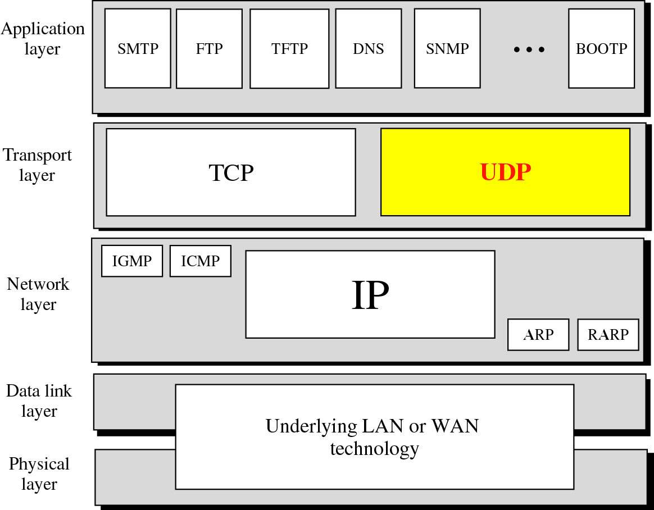

Slide 17
TCP/IP Protocol Architecture
Application Layer
  Communication between processes or applications
Transport Layer (TCP/UDP)
  End to end transfer of data
  May include reliability mechanism (TCP)
  Hides detail of underlying network
Internet Layer (IP)
  Routing of data
Network Access Layer

Slide 18
UDP
User Datagram Protocol
Transport layer protocol
Process to process communication
  Use port numbers
Connectionless
Unreliable
Perform very limited error checking
Very simple using a minimum of overhead

Slide 19
TCP
Transmission Control Protocol
Transport layer protocol
Process to process communication
Use port numbers
Reliable ( Use acknowledgements )
Connection oriented (Three way handshake)
Flow control (window size)

Slide 20
Port numbers
Well Known ports
  Range from 0 to 1,023
Registered ports
  Range from 1,024 to 49,151 not assigned or controlled by ICANN but can be registered at ICANN to avoid duplication
Dynamic ports
  Range from 49,152 to 65,535 are neither controlled nor registered

Slide 21
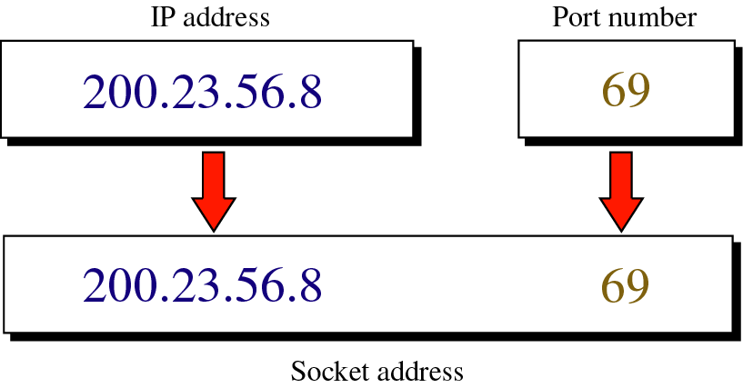
Socket Address

Slide 22
Addressing in TCP / IP

Slide 23
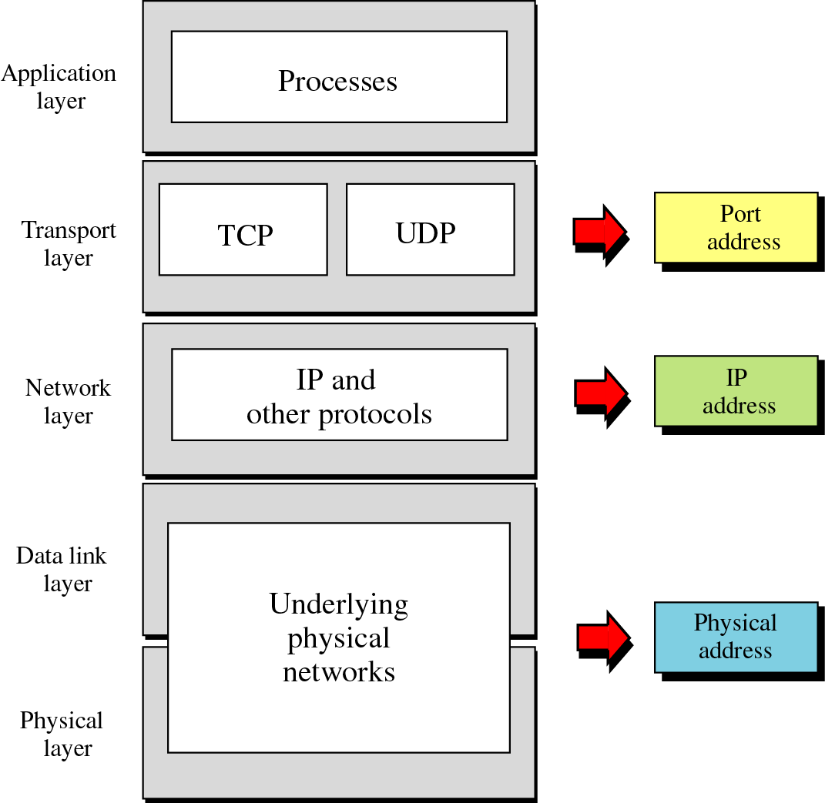
Relation-ship of layers and addresses in TCP/IP

Slide 24
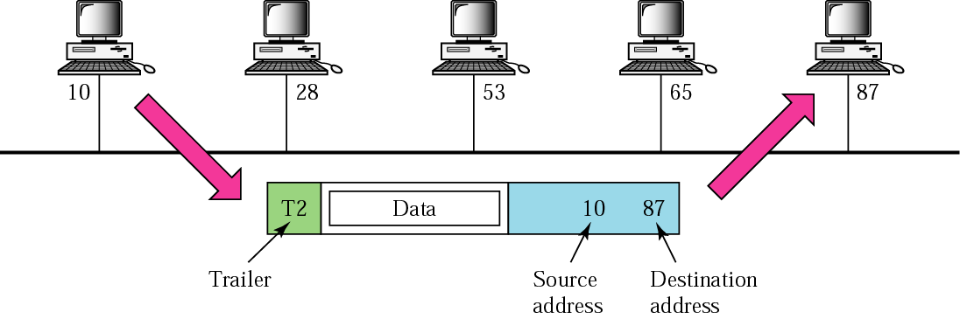
Physical Addresses

Slide 25
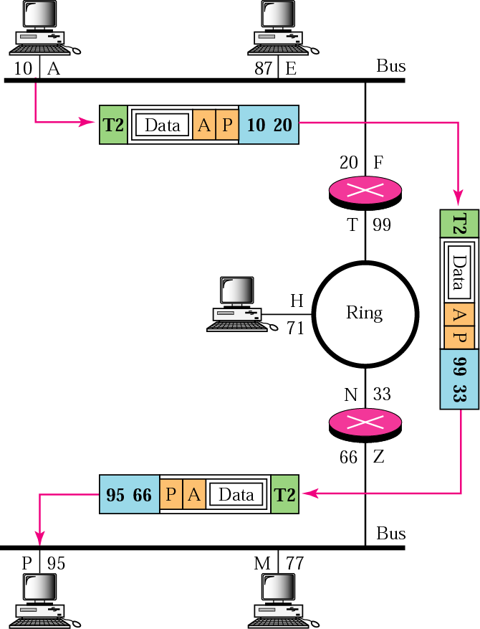
IP Addresses

Slide 26
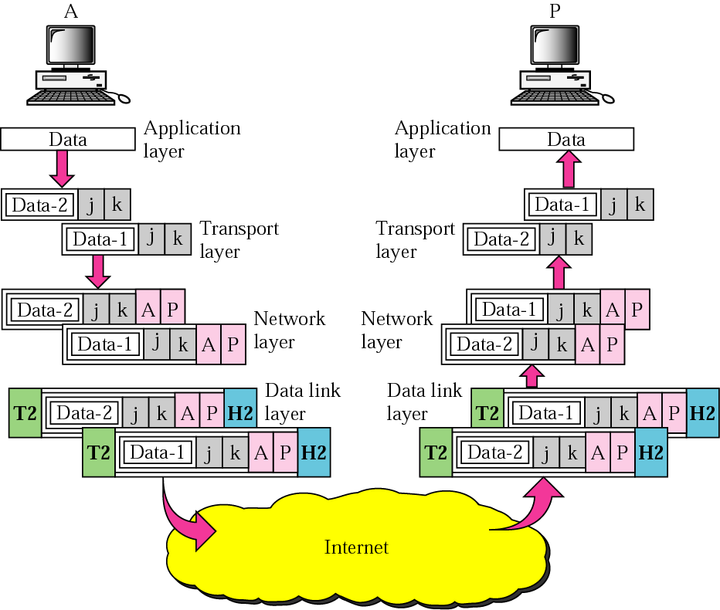
Port Addresses

Slide 27
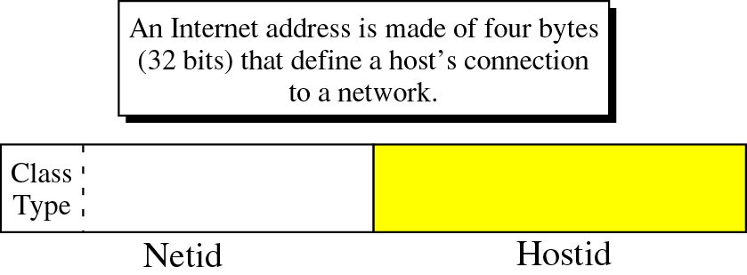
IP Address

Slide 28
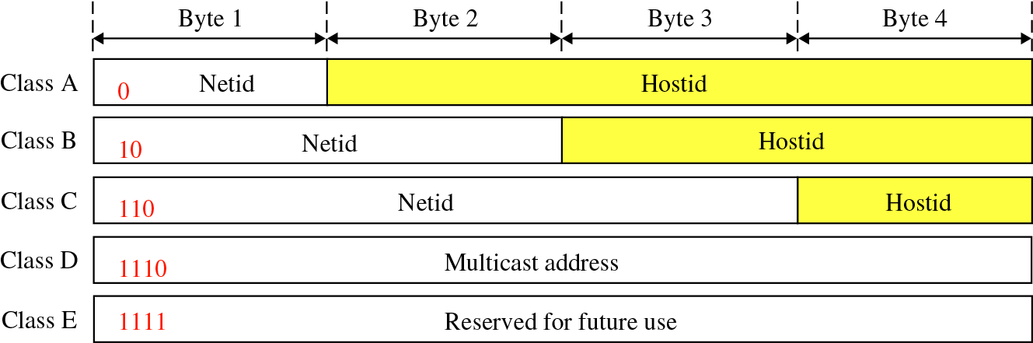
IP Address Classes

Slide 29
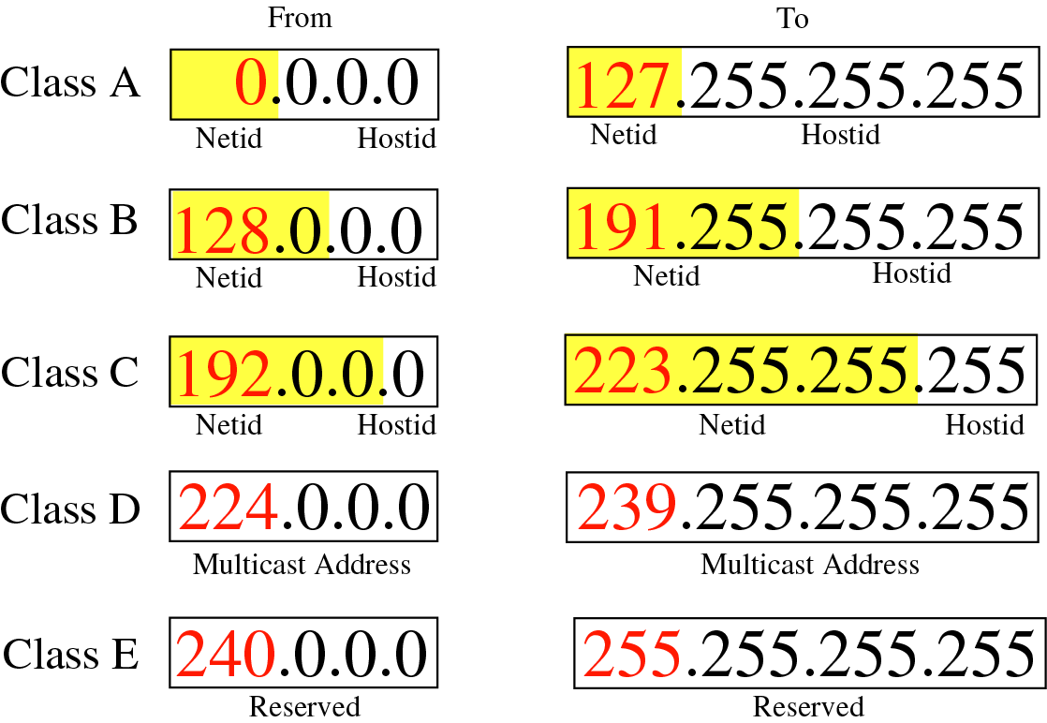
IP Address Classes

Slide 30
Special IP Addresses
Network address
Limited broadcast address
Direct Broadcast address
Loopback address

Slide 31
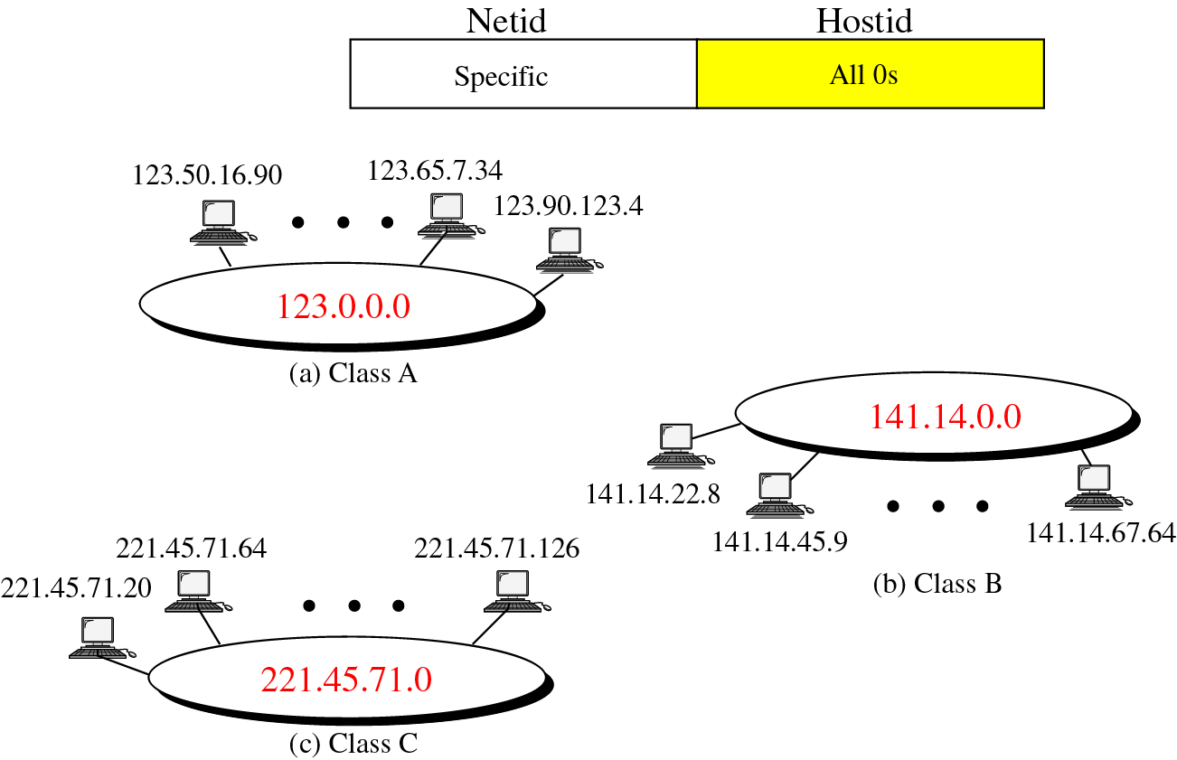
Network Address

Slide 32
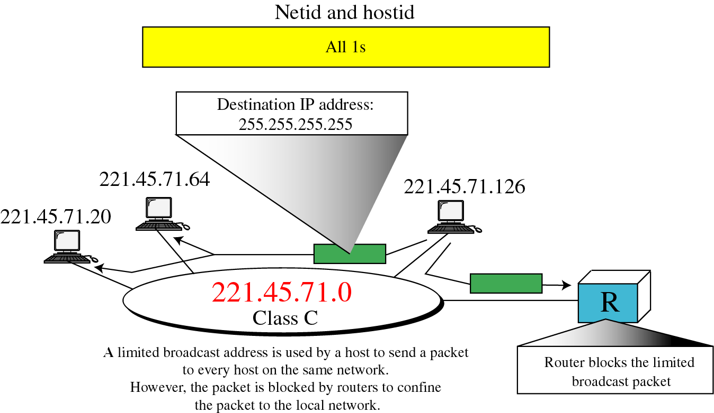
Limited Broadcast Address

Slide 33
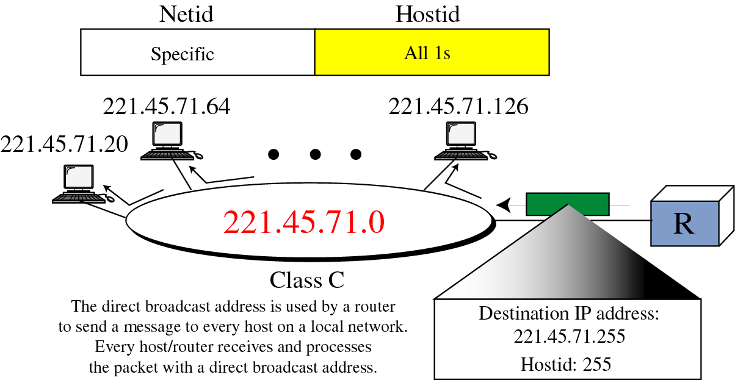
Direct Broadcast Address

Slide 34
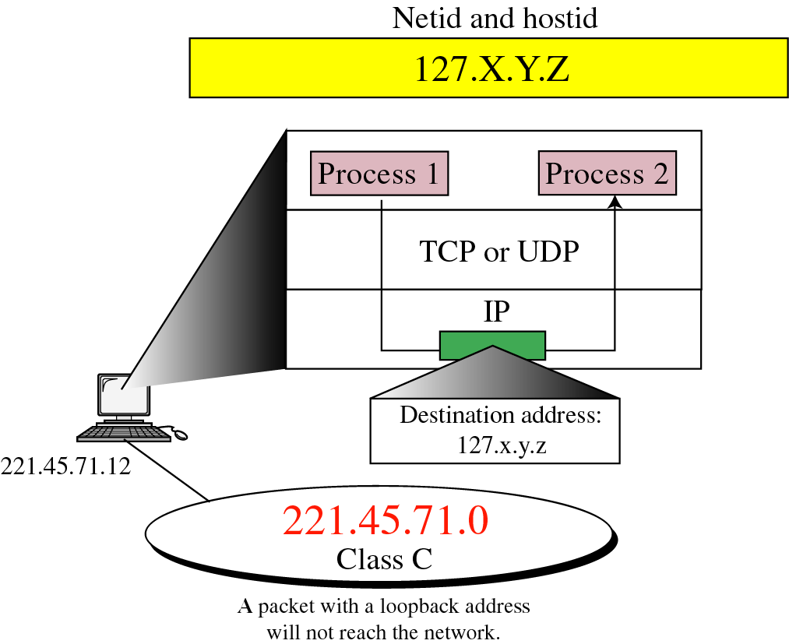
Loopback Address

Slide 35
Special IP Address
Private IP
  The Internet Assigned Numbers Authority (IANA) has reserved the following three blocks of the IP address space for private internets (local networks):
    10.0.0.0 - 10.255.255.255 >> Class A
    172.16.0.0 - 172.31.255.255 >> Class B
    192.168.0.0 - 192.168.255.255 >> Class C
Notes:
10.0.0.0 through 10.255.255.255
169.254.0.0 through 169.254.255.255 (APIPA only)
172.16.0.0 through 172.31.255.255
192.168.0.0 through 192.168.255.255

Slide 36
NAT
Network Address Translation
The process of modifying IP address information in IP packet headers while in transit
Simplest type: one-to-one translation of IP addresses
Types:
  Static
  Dynamic

Slide 37
Subnetting
In subnetting, a network is divided into smaller subnets with each subnet having its own subnet address.
Benefits of subnetting:
  Reduced network traffic
  Simplified management

Slide 38
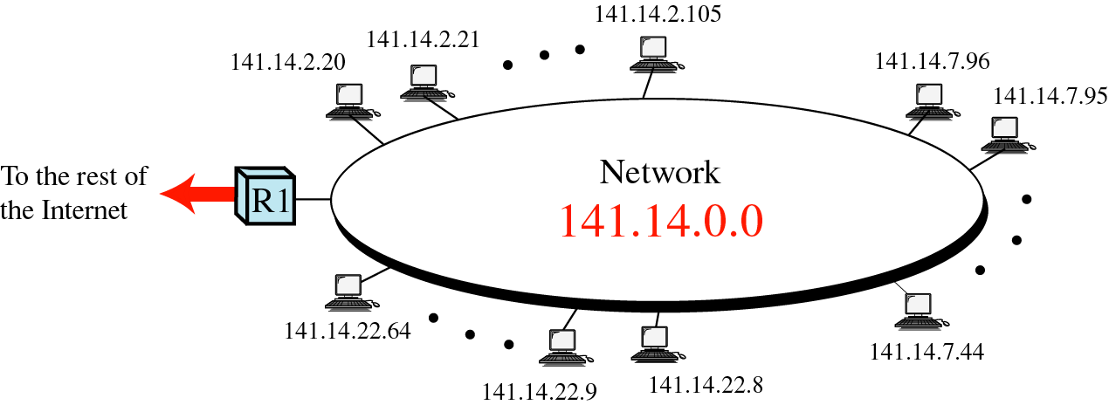
Network Before Subnetting

Slide 39
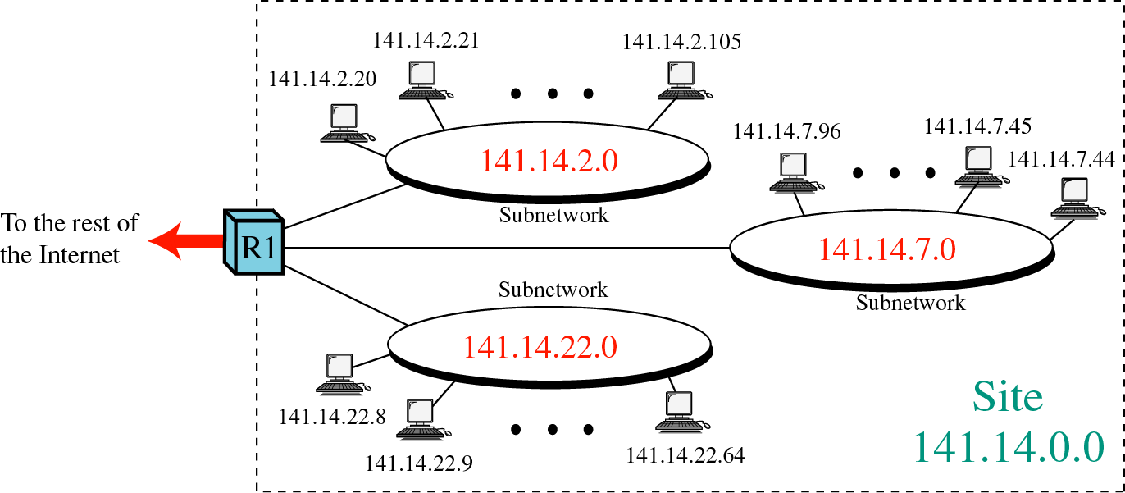
Network After Subnetting

Slide 40
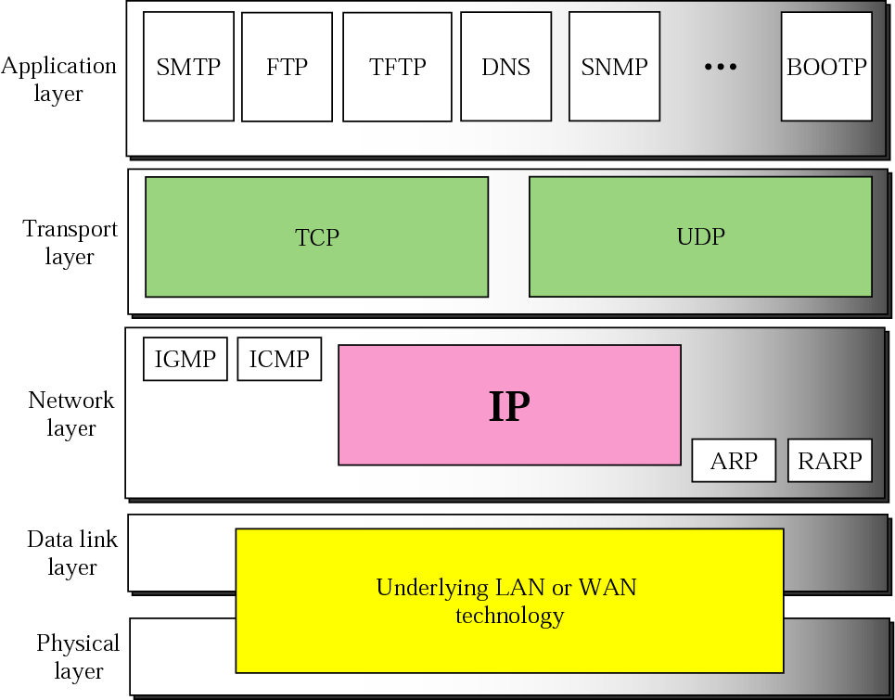
Network Layer

Slide 41
Delivery of IP Packets
Direct delivery
Indirect delivery

Slide 42
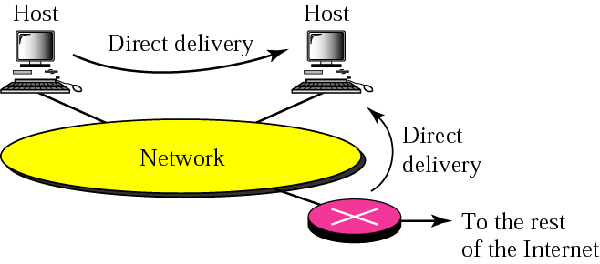
Direct delivery

Slide 43
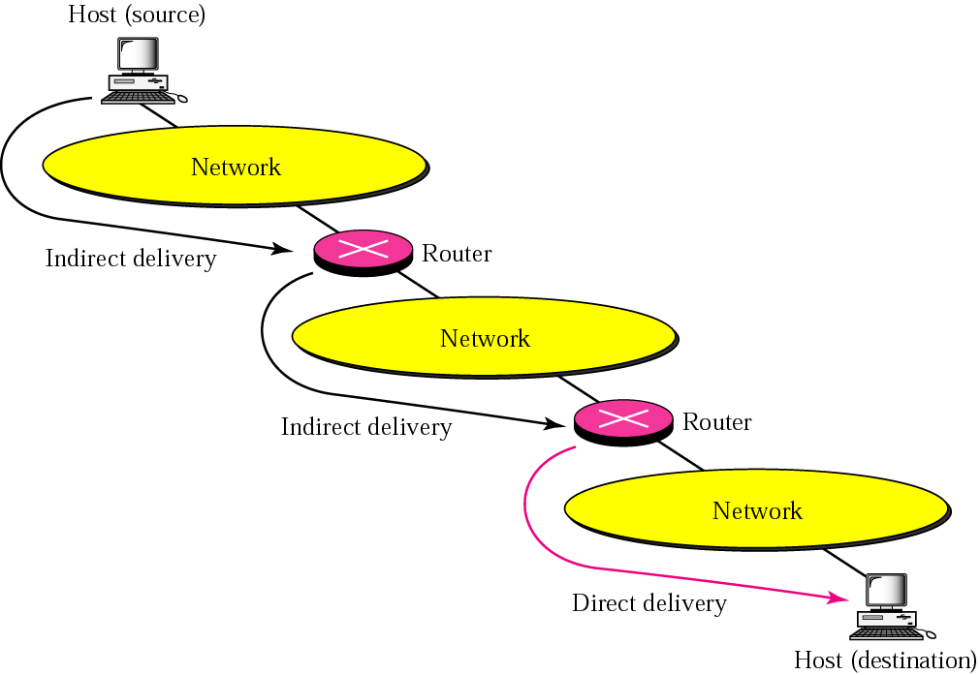
Indirect delivery

Slide 44
ARP

Slide 45
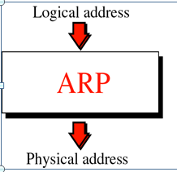
ARP
Address Resolution Protocol

Slide 46
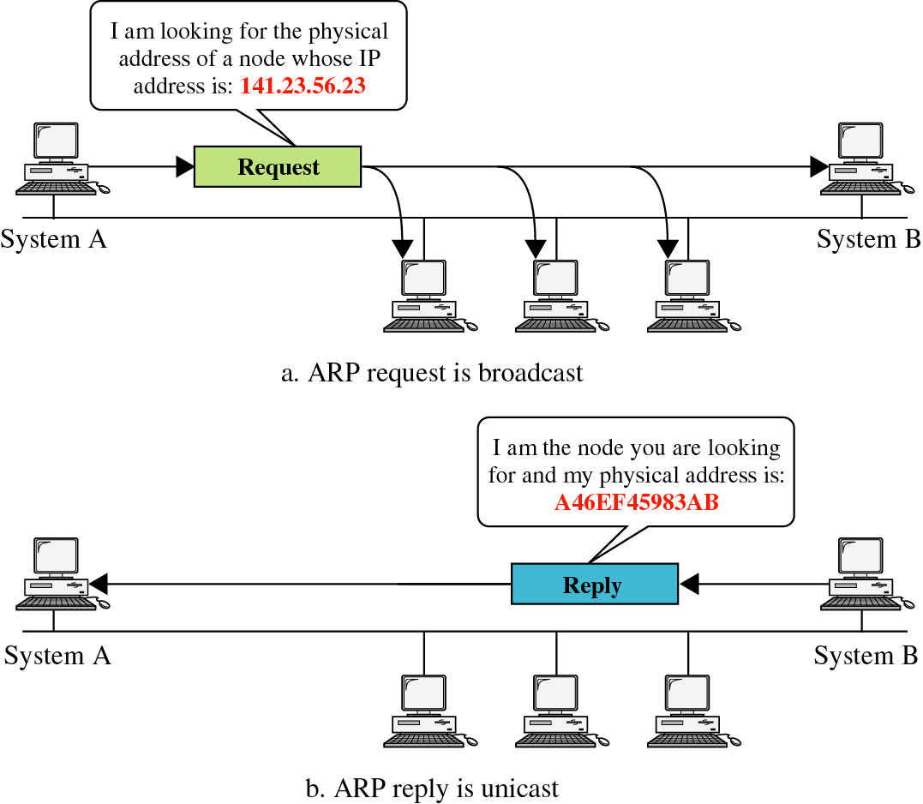
ARP operation

Slide 47
How to assign IP address to device
Manually
Automatic
APIPA

Slide 48
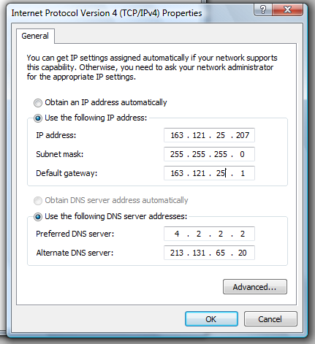
Assign IP address manually
Set IP address
Set Subnet mask
Set IP default-Gateway
Set DNS server
Notes:
1) Go to Start and click on Control Panel.
2) Control Panel window will appear. Double click on Network Connections.
3) Network Connections window will appear. Right click correct Local Area Connection by identifying correct network card and click Properties.
4) Select Internet Protocol (TCP/IP). Click on Properties.

Slide 49
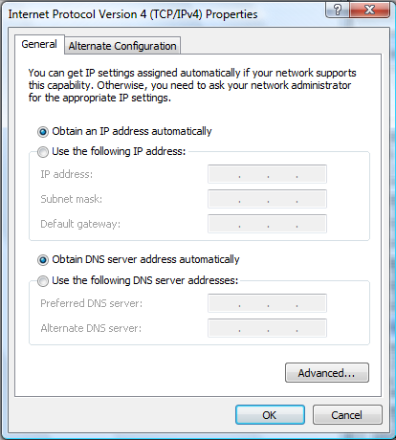
Assign IP address Automatic
The Device get the IP address through the DHCP Server.

Slide 50
APIPA
Automatic Private IP Addressing
APIPA feature, when installed – will automatically assign an IP to a computer if it is:
  Configured to obtain IP address automatically from DHCP
  And there is no DHCP server present or the DHCP server is not available
IANA (Internet Assigned Numbers Authority) has reserved private IP addresses in the range of 169.254.0.0 – 169.254.355.355

Slide 51
ipconfig
ipconfig is a command line utility in Microsoft Windows.
ipconfig allows you to get the IP address information of a Windows computer
  MAC Address
  IP address
  Default gateway
  Subnet mask
  DNS server
Notes:
C:\Users\nour>ipconfig
Windows IP Configuration
Ethernet adapter Local Area Connection:
Connection-specific DNS Suffix . :
Link-local IPv6 Address . . . . . : fe80::df8:969c:fdbf:cb4%9
IPv4 Address. . . . . . . . . . . : 163.121.12.207
Subnet Mask . . . . . . . . . . . : 255.255.255.0
Default Gateway . . . . . . . . . : 163.121.12.1
--------------------------------------------------------------------------------------------------
C:\Users\rania>ipconfig /all
Windows IP Configuration
Host Name . . . . . . . . . . . . : rania
Primary Dns Suffix . . . . . . . :
Node Type . . . . . . . . . . . . : Hybrid
IP Routing Enabled. . . . . . . . : No
WINS Proxy Enabled. . . . . . . . : No
Ethernet adapter Local Area Connection:
Connection-specific DNS Suffix . :
Description . . . . . . . . . . . : Broadcom NetXtreme 57xx Gigabit Controlle
r
Physical Address. . . . . . . . . : 00-13-72-A5-12-FE
DHCP Enabled. . . . . . . . . . . : No
Autoconfiguration Enabled . . . . : Yes
Link-local IPv6 Address . . . . . : fe80::df8:969c:fdbf:cb4%9(Preferred)
IPv4 Address. . . . . . . . . . . : 163.121.12.207(Preferred)
Subnet Mask . . . . . . . . . . . : 255.255.255.0
Default Gateway . . . . . . . . . : 163.121.12.1
DNS Servers . . . . . . . . . . . : 4.2.2.2
213.131.65.20
NetBIOS over Tcpip. . . . . . . . : Enabled

Slide 52
Internet Services
The World Wide Web: HTTP
File Transfer: FTP
Electronic Mail service: IMAP, POP3, SMTP
Naming Service: DNS
Telnet Service

Slide 53
Web Server and Clients

Slide 54
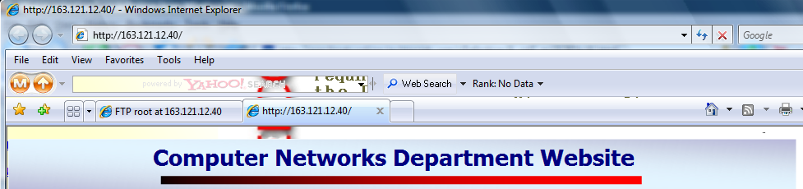
Browser as a web client
Use Internet Browser as WEB client.

Slide 55
FTP Server and Clients

Slide 56
FTP Client
Browser as a FTP client
Using MS Windows built-in FTP client
Third party programs “cute FTP”

Slide 57
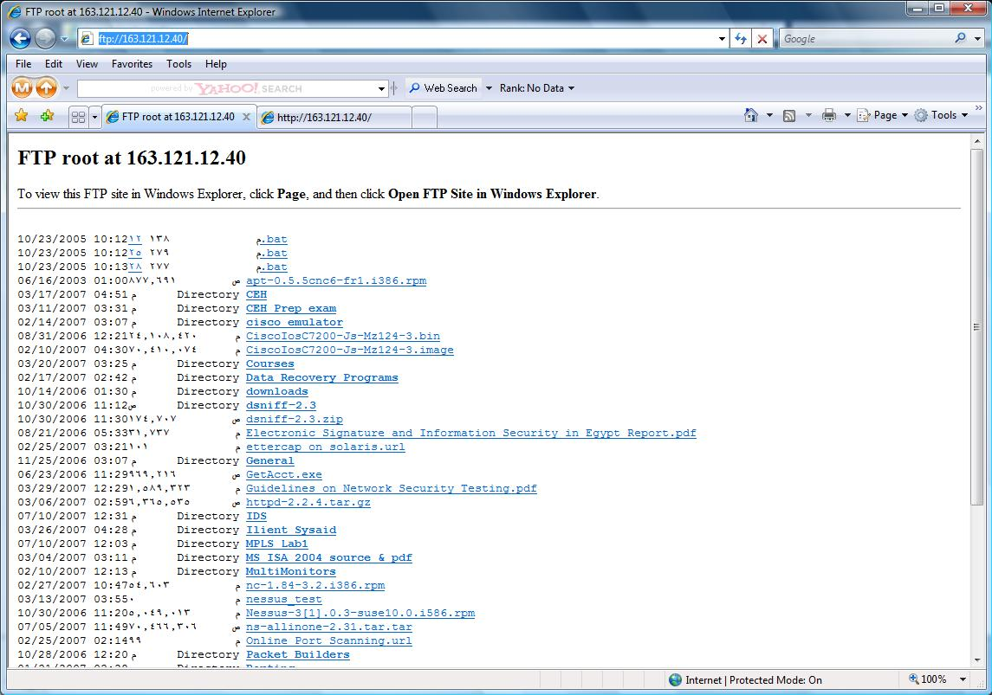
Browser as a FTP client
Use Internet Browser as FTP client.

Slide 58
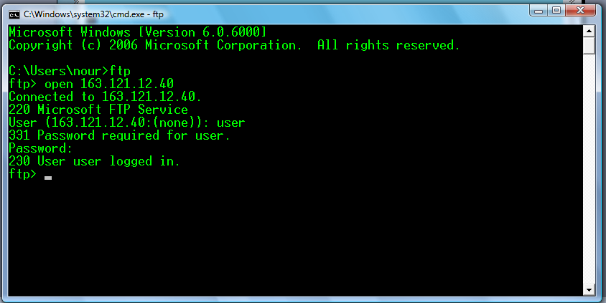
Using MS Windows built-in FTP client
Start >> run >> cmd
open
ls
cd
bin
get
mget
Put
bye
Try these commands

Slide 59
Mail Server and Clients

Slide 60
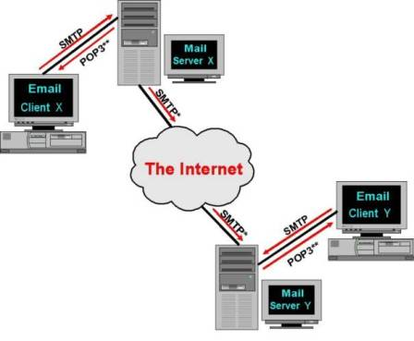
Mail Server

Slide 61
Mail Protocols
SMTP
  It is the common language used by the majority of Mail Servers to send messages back and forth to other Mail Servers or Email Clients
POP3 “Post Office Protocol version 3”
  In order to collect email messages from the Mail Server, the Email Client contacts the Mail Server.
  Download msgs on the H/D
  You can work Offline
  Keep the user’s quota on the server
IMAP4 “Internet Message Access Protocol version 4”
  Retrieve only msgs header

Slide 62
Mail Clients
Web based
Non web based
  Outlook express
  Microsoft Outlook

Slide 63
Telnet Services

Slide 64
Telnet
  Telnet is a user command and an underlying TCP/IP protocol for accessing remote computers.
  Through Telnet, an administrator can access someone else's computer remotely

Slide 65
Telnet client
Built in MS-Windows Telnet client
Third party programss

Slide 66
Naming Services

Slide 67

URL
URL is Universal Resource Locator
Protocol : HTTP or FTP

Slide 68
DNS
At the beginning they use Hosts file
It maps the IP addresses to host names
It is found at “C:\Windows\System32\drivers\etc”
Then they make DNS Server to centralize the Domain Name Servers.
Servers are used to convert the addresses we see and read into IP addresses and vice-versa.

Slide 69
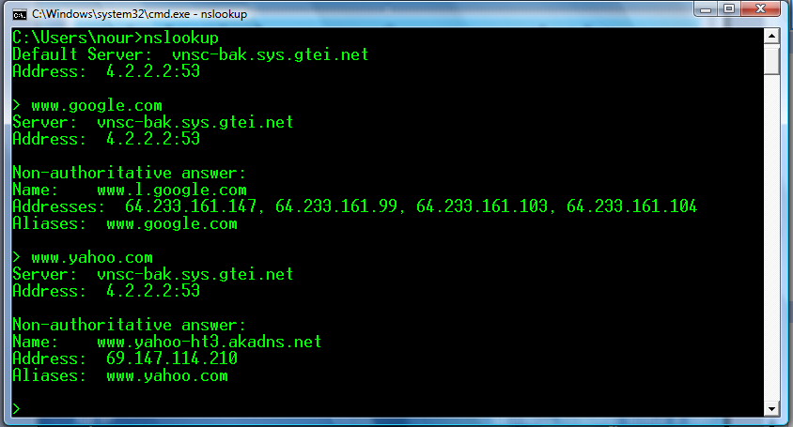
nslookup
nslookup is the name of a program that lets you to enter a host name and find out the corresponding IP address

Slide 70
Client/Server Examples
Client | Protocol | Server | Port No
Browser | HTTP | WEB | 80
Browser | FTP | FTP | 21
Browser Or Outlook Express Microsoft Outlook | HTTP SMTP POP3 IMAP4 | Mail | 110 143 25
Telnet | Telnet | Telnet | 23
Notes:
Note
POP3, IMAP4, Telnet, HTTP and SMTP operate using the TCP/IP Protocol
HTTP (HyperText Transfer Protocol)
HTTP is the standard language used for sending web pages.
FTP (File Transfer Protocol)
FTP used in the transmission of files.
Post Office Protocol (POP)
In order to collect email messages from the Mail Server, the Email Client contacts the Mail Server and supplies it with an account “user” name and a password. Only then will the Mail Server offer a count of pending messages stored for that account.
SMTP (Simple Mail Transfer Protocol)
Simple Mail Transfer Protocol (SMTP) a standard set of rules and procedures whereby messages could be transferred over the Internet. It is the common language used by the majority of Mail Servers to send messages back and forth to other Mail Servers or Email Clients.
The SMTP system uses Domain Name System (DNS) to convert the Domain Name component of a typical email address
DNS Server is (Domain Name Services)
The Internet works on IP addresses; DNS (Domain Name Services) Servers are used to convert the addresses we see and read into IP addresses and vice-versa.

Slide 71
IEEE LAN Standard

Slide 72
IEEE LAN Standards
IEEE: Institute of Electrical and Electronic Engineers
IEEE create standards for computer and communications
IEEE 802 series of standards for LAN technologies
IEEE defined several access methods
  CSMA/CD
  Token passing

Slide 73
Protocol Architecture
Lower layers of OSI model
IEEE 802 reference model
LAN layered protocol architecture
  Physical (topologies)
  Media access control
  Logical Link Control
All IEEE 802.x have the same LLC sublayer
MAC sublayer has very close relationship with the characteristics of physical medium and the topology of network

Slide 74
IEEE 802 versus OSI
Layer 7
Upper
Layers
Protocols
Layer 6
OSI
Reference
Model
IEEE 802
Reference Model
Layer 5
Layer 4
Layer 3
Data Link
Logic Link
Control
Media Access
Control
Scope of
IEEE 802
Standards
Physical
Physical

Slide 75
IEEE 802
802.1 Architecture and Internet
LLC
802.2 Logical Link Control
Data Link
Layer
802.3
Ethernet
802.4
Token Bus
802.11
Wireless
LAN
802.14
Cable
Modem
MAC
Physical Layer

Slide 76
Ethernet Technologies
The term Ethernet refers to the family of local-area network (LAN) products covered by the IEEE 802.3 standard that defines what is commonly known as the CSMA/CD protocol.
Data rates defined for operation over optical fiber and twisted-pair cables:
  10 Mbps—10Base-T Ethernet
  100 Mbps—Fast Ethernet
  1000 Mbps—Gigabit Ethernet
  10000Mbps—10Gigabit Ethernet

Slide 77
Half-Duplex Transmission — The CSMA/CD Access Method
The CSMA/CD protocol was originally developed as a means by which two or more stations could share a common media
It is used when the protocol does not require central arbitration, access tokens, or assigned time slots to indicate when a station will be allowed to transmit.
Each Ethernet MAC determines for itself when it will be allowed to send a frame.

Slide 78
CSMA/CD Access Rules
Carrier sense
  Each station continuously listens for traffic on the medium to determine when gaps between frame transmissions occur.
Multiple access
  Stations may begin transmitting any time they detect that the network is quiet (there is no traffic).
Collision detect
  This means that if any collision occurs, it will be detected immediately

Slide 79

The Basic Ethernet Bus
  Machine 2 wants to send a message to machine 4
  First it 'listens' to make sure no one else is using the network.
  If it is all clear it starts to transmit its data on to the network
  The signal moves down the cable and is received by every machine on the network but because it is only addressed to number 4, the other machines ignore it.
  Machine 4 then sends a message back to number 1 acknowledging receipt of the data

Slide 80
Collisions
  machine 2 and machine 5 both trying to transmit simultaneously.
  The resulting collision destroys both signals
  Both machines then wait for a random period of time before re-trying.
Notes:
On small networks this all happens so quickly that it is virtually unnoticeable, however, as more and more machines are added to a network the number of collisions rises dramatically and eventually results in slow network response.

Slide 81
Full-Duplex Transmission
Full-duplex operation is an optional MAC capability that allows simultaneous two-way transmission over point-to-point links.
Full duplex transmission is functionally much simpler than half-duplex transmission because it involves no media contention, no collisions, and no need to schedule retransmissions.

Slide 82
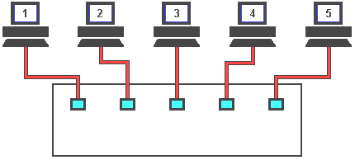
Full-Duplex Transmission
To overcome the problem of collisions and other effects on network speed, a switch is used.
With a switch, machines can transmit simultaneously
Notes:
As you can see, the switch reads the destination addresses and 'switches' the signals directly to the recipients without broadcasting to all of the machines on the network. This 'point to point' switching alleviates the problems associated with collisions and considerably improves network speed.
In the real world however, one or more of these machines will be servers, and as most network traffic is between the clients and a server a serious bottle neck can occur. The answer to this problem is to make server connections faster than the clients. The normal solution is to have the client machines on 10Mbs ports and the servers on 100Mbs ports. This ten to one ratio is usually adequate because not all of the clients will need to access the servers at the same time.

Slide 83
Devices Used in Networking
Networking Devices
  Repeater
  Hub
  Bridge
  Switch
Internetworking Devices
  Router

Slide 84
Devices Used in Networking
Repeater
  A repeater is an electronic device that receives a weak or low-level signal and retransmits it at a higher level or higher power, so that the signal can cover longer distances without degradation.
  Can connect computers that are far from each other
  Operate at the physical layer of OSI/RM

Slide 85
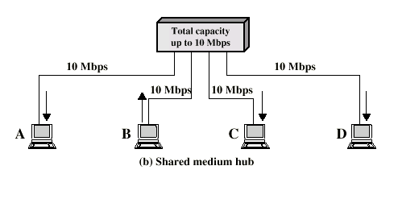
Devices Used in Networking
Hubs
  Operate at the physical layer of OSI/RM
  Hub retransmits incoming signal to all outgoing lines
  Only one station can transmit at a time
  With a 10Mbps LAN, total capacity is 10Mbps

Slide 86
Devices Used in Networking
Bridges
  A network bridge connects multiple network segments at the Data Link Layer.
  Network bridges filter frames to determine whether a specific frame belongs on a local segment or another LAN segment
  Use hardware address to determine which segment will receive the frame
  Operate at the layer 2 of OSI/RM
  Reduce network traffic
  Connect network segments with same or different DLL protocol
Notes:
Bridges are similar to repeaters or network hubs, devices that connect network segments at the physical layer, however a bridge works by using bridging where traffic from one network is managed rather than simply rebroadcast to adjacent network segments.

Slide 87
Devices Used in Networking
Switches
  A device that connects PCs in star configured networks
  Faster than hubs and bridges
  Benefits:
    Simple installation
    Higher speed
    More server bandwidth
  Can operate at several layers of OSI/RM
  Each device has dedicated capacity equal to the LAN capacity

Slide 88
Devices Used in Networking
Layer 2 switch
  LAN switch
  Forwards traffic based on the MAC address
Layer 3 switch
  Routing switch
  Forwards traffic based on IP Address
  Used for Inter-VLAN routing
  Don’t have WAN connectivity

Slide 89
Bridging vs. LAN Switching
Bridges are software based, while switches are hardware based because they use ASIC chips to help make filtering decisions.
Switches have a higher number of ports than most bridges.
Both bridges and switches forward layer 2 broadcasts.
Bridges and switches learn MAC addresses by examining the source address of each frame received.
Both bridges and switches make forwarding decisions based on layer 2 addresses.

Slide 90
Devices Used in Networking
Routers
  A device that connects any number of LANs.
  Used to redirect packets between networks
  Use headers and a forwarding table to determine where packets go.
  Use network layer address ( IP Address)
  Operate at the network layer of OSI/RM

Slide 91
Collision Domain vs. Broadcast Domain
Collision Domain
  It consists of all devices (NICs) that can see or be involved in a collision.
Broadcast Domain
  It consists of all devices that can see the broadcast.
Generally, layer 2 devices border a collision domain, while layer 3 devices border a broadcast domain.

Slide 92
Collision Domain vs. Broadcast Domain
Hub
Switch
Broadcast Domain Boundaries
R
Collision Domain Boundaries

Slide 93
ARP and RARP

Slide 94
ARP and RARP
ARP
  Address Resolution Protocol
RARP
  Reverse Address Resolution Protocol

Slide 95
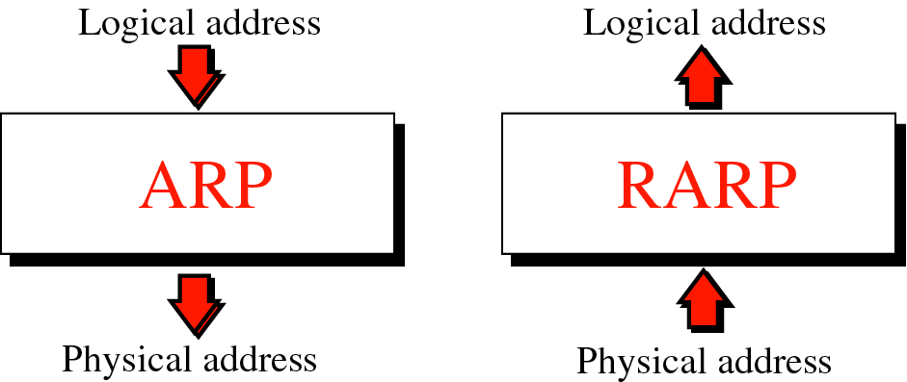
ARP and RARP

Slide 96
Fragmentation
Some physical networks are not able to encapsulate a datagram of 65,535 bytes in their frames
  The datagram must be fragmented to pass through this network
  Each fragment has its own header with most of fields repeated, but some changed
  A fragment datagram may be fragmented if it encounters network with smaller MTU
  Each fragment becomes an independent datagram
  Fragments of same datagram may follow any path

Slide 97
Thank you

